Slide 1
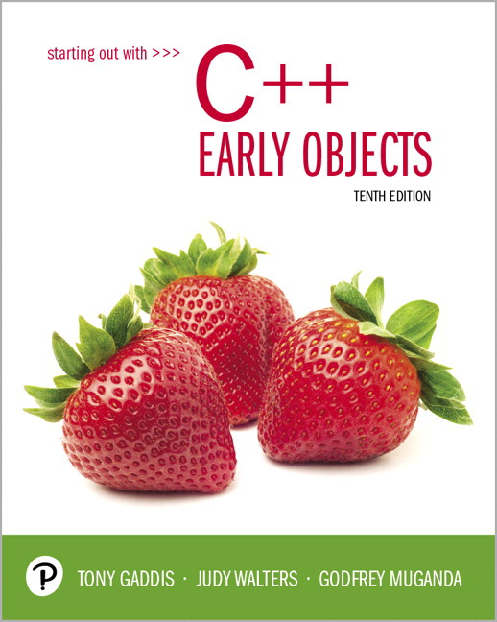
Starting Out with C++ Early Objects
Tenth Edition
Chapter 4
Making Decisions

Slide 2
Topics 1 of 2
4.1 Relational Operators
4.2 The if Statement
4.3 The if/else Statement
4.4 The if/else if Statement
4.5 Menu-Driven Programs
4.6 Nested if Statements
4.7 Logical Operators

Slide 3
Topics 2 of 2
4.8 Validating User Input
4.9 More About Block and Scope
4.10 More About Characters and Strings
4.11 The Conditional Operator
4.12 The switch Statement
4.13 Enumerated Data Types

Slide 4
4.1 Relational Operators
Are used to compare numeric and char values to determine relative order
Operator | Meaning
> | Greater than
< | Less than
>= | Greater than or equal to
<= | Less than or equal to
== | Equal to
!= | Not equal to

Slide 5
Relational Expressions 1 of 2
Relational expressions are Boolean (i.e., evaluate to true or false)
Examples:
12 > 5 is true
7 <= 5 is false
if x is 10, then
x == 10 is true,
x <= 8 is false,
x != 8 is true, and
x == 8 is false

Slide 6
Relational Expressions 2 of 2
The value can be assigned to a variable
bool result = (x <= y);
Assigns 0 for false, 1 for true
Do not confuse = (assignment) and == (equal to)
Notes:
See pr4-01.cpp

Slide 7
Hierarchy of Relational Operators
Use this when evaluating an expression that contains multiple relational operators
Operator | Precedence
> >= < <= | Highest
== != | Lowest

Slide 8
4.2 The if Statement
Supports the use of a decision structure, giving a program more than one path of execution
Allows statements to be conditionally executed or skipped over
It models the way we evaluate real-life situations
“If it is cold outside,
wear a coat and wear a hat.”

Slide 9
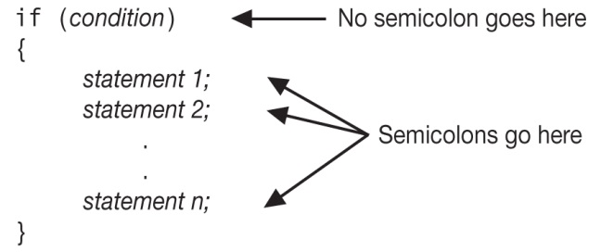
Format of the if Statement
The block of statements inside the braces is called the body of the if statement. If there is only 1 statement in the body, the { } may be omitted.
Notes:
See pr4-02.cpp

Slide 10
How the if Statement Works
If (condition) is true, then the statement(s) in the body are executed.
If (condition) is false, then the statement(s) are skipped.

Slide 11
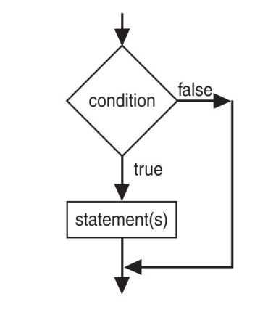
if Statement Flow of Control

Slide 12
Example if Statements
if (score >= 60)
cout << "You passed." << endl;
if (score >= 90)
{
grade = 'A';
cout << "Wonderful job!" << endl;
}

Slide 13
if Statement Notes
if is a keyword. It must be lowercase
(condition)must be in ( )
Do not place ; after (condition)
Don't forget the { } around a multi-statement body
Don’t confuse = (assignment) with == (comparison)

Slide 14
if Statement Style Recommendations
Place each statement; on a separate line after (condition)
Indent each statement in the body
When using { and } around the body, put { and } on lines by themselves

Slide 15
What is true and what is false?
An expression whose value is 0 is considered false.
An expression whose value is non-zero is considered true.
An expression need not be a comparison – it can be a single variable or a mathematical expression.

Slide 16
Flag
A variable that signals a condition
Usually implemented as a bool
Meaning:
true: the condition exists
false: the condition does not exist
The flag value can be both set and tested with if statements

Slide 17
Flag Example
Example:
bool validMonths = true;
…
if (months < 0)
validMonths = false;
…
if (validMonths)
monthlyPayment = total / months;

Slide 18
Integer Flags
Integer variables can be used as flags
Remember that 0 means false, any other value means true
int allDone = 0; // set to false
…
if (count > MAX_STUDENTS)
allDone = 1; // set to true
…
if (allDone)
cout << "Task finished";

Slide 19
4.3 The if/else Statement
Allows a choice between statements depending on whether (condition) is true or false
Format: if (condition)
{
statement set 1;
}
else
{
statement set 2;
}

Slide 20
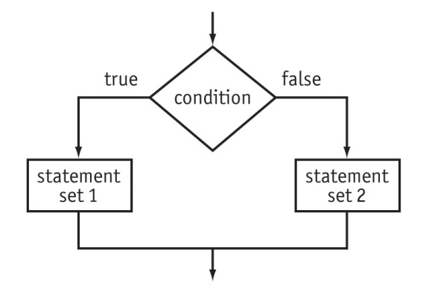
if/else Flow of Control

Slide 21
How the if/else Works
If (condition) is true, statement set 1 is executed and statement set 2 is skipped.
If (condition) is false, statement set 1 is skipped and statement set 2 is executed.
Notes:
See pr4-03.cpp

Slide 22
Example if/else Statements
if (score >= 60)
cout << "You passed.\n";
else
cout << "You did not pass.\n";
if (intRate > 0)
{ interest = loanAmt * intRate;
cout << interest;
}
else
cout << "You owe no interest.\n";
Notes:
See pr4-04.cpp

Slide 23
if vs. if/else
If there are two conditions and both of them can be true or both can be false, then use two if statements:
if (num > 0)
cout << num << " is positive\n";
if (num %2 == 0)
cout << num << " is even\n";
If the two conditions cannot both be true, then a single if/else statement can work:
if (num %2 == 0)
cout << num << " Is even\n";
else
cout << num << " Is odd\n";

Slide 24
Comparisons with Floating-Point Numbers
It is difficult to test for equality when working with floating point numbers.
It is better to use
greater-than or less-than tests, or
test to see if value is very close to a given value
Notes:
See pr4-05.cpp and pr4-06.cpp

Slide 25
4.4 The if/else if Statement
Chain of if statements that test in order until one is found to be true
This also models thought processes
“If it is raining, take an umbrella,
else, if it is windy, take a hat,
else, if it is sunny, take sunglasses.”

Slide 26
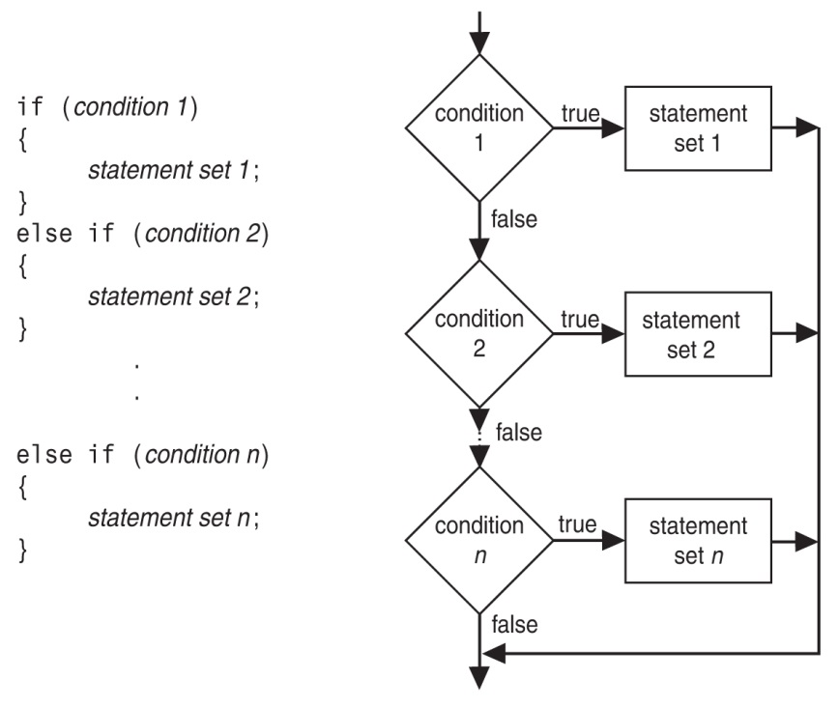
if/else if Format
Notes:
See pr4-07.cpp, compare to pr4-08.cpp

Slide 27
Using a Trailing else
Is used with a set of if/else if statements
It provides a default statement or action that is performed when none of the conditions is true
It can be used to catch invalid values or handle other exceptional situations

Slide 28
Example if/else if with Trailing else
if (age >= 21)
cout << "Adult";
else if (age >= 13)
cout << "Teen";
else if (age >= 2)
cout << "Child";
else
cout << "Baby";
Notes:
See pr4-09.cpp

Slide 29
4.5 Menu-Driven Program
Menu: list of choices presented to the user on the computer screen
Menu-driven program: program execution controlled by user selecting from a list of actions
A menu-driven program can be written using if/else if statements

Slide 30
Menu-driven Program Organization
Display a list of numbered or lettered choices for actions.
Input user’s selection of number or letter
Test user selection in (condition)
if a match, then execute code to carry out desired action
if not, then test with next (condition)
Notes:
See pr4-10.cpp

Slide 31
4.6 Nested if Statements
An if statement that is part of the if or else part of another if statement
This can be used to evaluate > 1 data item or to test > 1 condition
if (score < 100)
{
if (score > 90)
grade = 'A';
}

Slide 32
Notes on Coding Nested ifs
An else matches the nearest previous if that does not have an else
if (score < 100)
if (score > 90)
grade = 'A';
else ... // goes with second if,
// not first one
Proper indentation aids comprehension
Notes:
See pr4-11.cpp

Slide 33
4.7 Logical Operators
Are used to create relational expressions from other relational expressions
Operator | Meaning | Explanation
&& | AND | New relational expression is true if both expressions are true
|| | OR | New relational expression is true if either expression is true
! | NOT | Reverses the truth value of an expression; true expression becomes false, false expression becomes true

Slide 34
Logical Operator Examples
int x = 12, y = 5, z = -4;
Expression | Value
(x > y) && (y > z) | true or 1
(x > y) && (z > y) | false or 0
(x <= z) || (y == z) | false
(x <= z) || (y != z) | true
!(x >= z) | false
Notes:
See pr4-12.cpp, pr4-13.cpp, pr4-14.cpp, and pr4-15.cpp

Slide 35
Logical Operator and bool Variables
Logical operators can be used with bool variables as well as expressions that evaluate to true or false.
Ex:
bool done = false;
if ((!done) && (count < 6))
{
. . .
}

Slide 36
Short-Circuit Evaluation
If an expression using the && operator is being evaluated and the subexpression on the left side is false, then there is no reason to evaluate the subexpression on the right side. It is skipped.
If an expression using the || operator is being evaluated and the subexpression on the left side is true, then there is no reason to evaluate the right side. It is skipped.

Slide 37
Logical Precedence
Highest !
&&
Lowest ||
Example:
(2 < 3) || (5 > 6) && (7 > 8)
is true because && is evaluated before | |

Slide 38
Checking Numeric Ranges with Logical Operators
Used to test if a value is within a range
if ((grade >= 0) && (grade <= 100))
cout << "Valid grade";
Can also test if a value lies outside a range
if ((grade <= 0) || (grade >= 100))
cout << "Invalid grade";
You cannot use mathematical notation
if (0 <= grade <= 100) //Doesn’t
//work!

Slide 39
4.8 Validating User Input
Input validation: inspecting input data to determine if it is acceptable
You want to avoid accepting bad input
You can perform various tests
Range
Reasonableness
Valid menu choice
Zero as a divisor
Notes:
See pr4-16.cpp

Slide 40
4.9 More About Blocks and Scope
The Scope of a variable is the block in which it is defined, from the point of definition to the end of the block
Variables are usually defined at the beginning of a function
They may instead be defined close to the place where they are first used
Notes:
See pr4-17.cpp

Slide 41
More About Blocks and Scope
Variables defined inside { } have local or block scope
When in a block that is nested inside another block, you can define variables with the same name as in the outer block.
When the program is executing in the inner block, the outer definition is not available.
This generally not a good idea. The program may be hard to read or understand.
Notes:
See pr4-18.cpp

Slide 42
4.10 More About Characters and Strings
You can use relational operators with characters and string objects
if (menuChoice == 'A'), or if (name1 >= name2)
Comparing characters is really comparing the ASCII values of characters
Comparing string objects is comparing the ASCII values of the characters in the strings. Comparison is character-by-character, starting with the first character of each string.
You cannot compare C-style strings by using relational operators
Notes:
See pr4-19.cpp and pr4-20.cpp

Slide 43
Testing Characters 1 of 2
These functions require the cctype header file
FUNCTION | MEANING
isalpha | true if arg. is a letter, false otherwise
isalnum | true if arg. is a letter or digit, false otherwise
isdigit | true if arg. is a digit 0-9, false otherwise
islower | true if arg. is lowercase letter, false otherwise

Slide 44
Testing Characters 2 of 2
These functions require the cctype header file
FUNCTION | MEANING
isprint | true if arg. is a printable character, false otherwise
ispunct | true if arg. is a punctuation character, false otherwise
isupper | true if arg. is an uppercase letter, false otherwise
isspace | true if arg. is a whitespace character, false otherwise
Notes:
See pr4-21.cpp

Slide 45
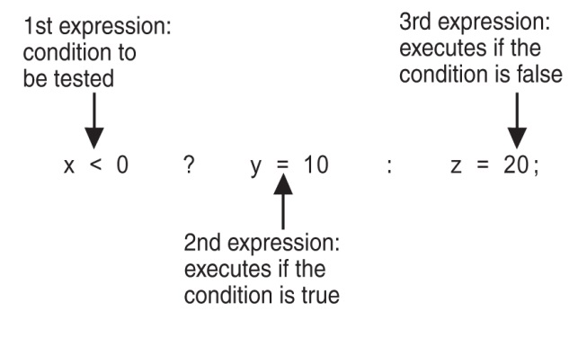
4.11 The Conditional Operator
This can be used to create short if/else statements
Format: expr ? expr : expr;

Slide 46
The Value of a Conditional Expression
A conditional expression is an expression that uses a conditional operator
The value of a conditional expression is determined by whichever of the subexpressions is executed
int num = 13;
string result= (num%2 ==0) ? "even" : "odd";
cout << num << " is " << result;
Notes:
See pr4-22.cpp

Slide 47
4.12 The switch Statement
It uses the value of an integer expression to determine the statements to execute
It may sometimes be used instead of if/else if statements

Slide 48
switch Statement Format
switch (IntExpression)
{
case exp1: statement set 1;
case exp2: statement set 2;
...
case expn: statement set n;
default: statement set n+1;
}

Slide 49
switch Statement Requirements
IntExpression must be an integer variable or a char,or an expression that evaluates to an integer value
exp1 through expn must be constant integer type expressions and must be unique in the switch statement
default is optional but recommended

Slide 50
How the switch Statement Works
IntExpression is evaluated
The value of IntExpression is compared against exp1 through expn.
If IntExpression matches value expi, the program branches to the statement(s) following expi and continues to the end of the switch
If no matching value is found, the program branches to the statement after default:

Slide 51
The break Statement
Is used to stop execution in the current block
It is also used to exit a switch statement
It is used to execute the statements for a single case expression without executing the statements of the cases following it
Notes:
See pr4-23.cpp, pr4-24.cpp, pr4.25.cpp, and pr4-26.cpp

Slide 52
Example switch Statement
switch (plusOrMinus)
{
case '+': cout << "plus";
break;
case '-': cout << "minus";
break;
default : cout << "invalid value";
}

Slide 53
Using switch with a Menu
A switch statement is a natural choice for a menu-driven program
display menu
get user input
use user input as IntExpression in switch
statement
use menu choices as exp values to test against in the case statements
Notes:
See pr4-27.cpp

Slide 54
4.13 Enumerated Data Types
Is a data type created by the programmer
Contains a set of named integer constants
Format:
enum name {val1, val2, … valn};
Examples:
enum Fruit {apple, grape, orange};
enum Days {Mon, Tue, Wed, Thur, Fri};

Slide 55
Enumerated Data Type Variables
To define variables, use the enumerated data type name
Fruit snack;
Days workDay, vacationDay;
A variable may contain any valid value for the data type
snack = orange; // no quotes
if (workDay == Wed) // none here either
Notes:
See pr4-28.cpp

Slide 56
Comparison of Enumerated Data Type Values
Enumerated data type values are associated with integers, starting at 0
enum Fruit {apple, grape, orange};
You can override the default association
enum Fruit {apple = 2, grape = 4,
orange = 5};
0
1
2

Slide 57
Enumerated Data Type Values
Enumerated data type values can be compared using their integer values
if (snack == 1)
Enumerated data type values cannot be assigned using their integer values
snack = 2; // won't work

Slide 58
Enumerated Data Type Notes
Enumerated data types improve the readability of a program
Enumerated variables can not be used with input statements, such as cin
An enumerated variable will not display the name associated with the value of an enumerated data type if used with cout

Slide 59

Copyright

